Slide 1

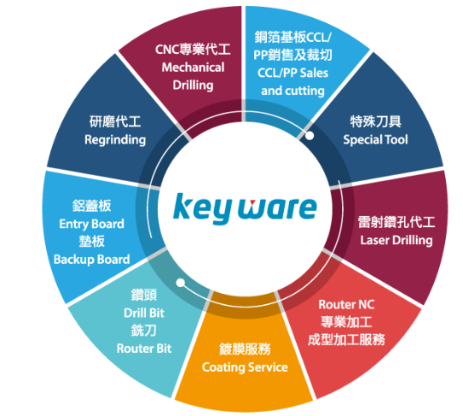
Investor Relations Presentation
2024Q2 & H1
Date：2024/8/22
KEY WARE ELECTRONICS CO., LTD.
5498.TW

Slide 2
Safe Harbor Notice
The information contained in this presentation, including all forward-looking statements, is subject to change without notice, whether as a result of new information, future events or otherwise, and KEY WARE ELECTRONICS CO., LTD. (the “Company”) undertakes no obligation to update or revise the information contained in this presentation.
Actual results may differ materially from those expressed or implied in these forward-looking statements, and no representation or warranty, either expressed or implied, is provided in relation to the accuracy, completeness or reliability of the information contained herein, nor is the information intended to be a complete statement of the Company, markets or developments referred to in this presentation.

Slide 3
MAIN POINTS
Financial
Results
Capacity Enhancement
Expansion of Operational Locations
ESG Progress
1
3
2
4

Slide 4
Financial Results
ESG Progress
Expansion of Operational Locations
Capacity Enhancement
Consolidated Income Statement – by Quarterly
NT$ million | Y23-Q2 | Y24-Q1 | Y24-Q2 | QoQ | YoY
Net Revenue | 244 | 261 | 315 | 21% | 29%
Gross Profit | -6 | 15 | 31 | 101% | 633%
Operating Expenses | 34 | 29 | 37 | 26% | 9%
Operating Income | -40 | -14 | -6 | 58% | 85%
Non-operating Income and Expenses | 12 | 38 | -10
Net Profit Attributable to the Company | -28 | 16 | -8 | -150% | 71%
EPS (dollars) | -0.14 | 0.08 | -0.04
Gross Margin % | -2% | 6% | 10%
OP Margin % | -16% | -5% | -2%
Net Margin % | -11% | 6% | -2%
Financial statements were prepared in accordance with TIFRS on a consolidated basis.

Slide 5
Financial Results
ESG Progress
Expansion of Operational Locations
Capacity Enhancement
Consolidated Income Statement – Cumulative
NT$ million | Y23-H1 | Y24-H1 | YoY
Net Revenue | 493 | 576 | 17%
Gross Profit | -67 | 47 | 170%
Operating Expenses | 69 | 66 | -4%
Operating Income | -136 | -19 | 86%
Non-operating Income and Expenses | 393 | 27
Net Profit Attributable to the Company | 150 | 8 | -95%
EPS (dollars) | 0.78 | 0.04
Gross Margin % | -14% | 8%
OP Margin % | -28% | -3%
Net Margin % | 30% | 2%
Financial statements were prepared in accordance with TIFRS on a consolidated basis.

Slide 6
Financial Results
ESG Progress
Expansion of Operational Locations
Capacity Enhancement
Consolidated Balance Sheet
NT$ million | Y23-Q2 | Y24-Q1 | Y24-Q2 | Main Reasons for Changes
Cash and cash equivalents | 278 | 248 | 364 | Land payment subsidy
Notes & Accounts receivables* | 548 | 553 | 600 | Revenue growth
Inventories | 451 | 478 | 506
TOTAL ASSETS | 3,825 | 3,818 | 3,992
Total Loans** | 1,161 | 1,168 | 1,308 | Operations, bond redemption, and short-term investments
TOTAL LIABILITIES | 1,687 | 1,739 | 1,820
TOTAL EQUITY | 2,113 | 2,062 | 2,154
ROA% | 3.8% | 0.4% | 0.2%
ROE% | 6.9% | 0.8% | 0.4%
The accompanying notes are an integral part of these consolidated financial statements.
* Notes & Accounts receivables include Notes receivables, Accounts receivables, Accounts receivable-related parties.
**Total Loans include Short-term loans, Short-term notes and bills payable, Long-term liabilities with a maturity of less than one year, Long-term loans.

Slide 7
ESG Progress
Expansion of Operational Locations
Capacity Enhancement
Financial Results
Consolidated Cash Flow
NT$ million | Y23-Q2 | Y24-Q1 | Y24-Q2
Beginning Cash Balance | 158 | 138 | 248
Cash from operating activities | -37 | -9 | -70
Capital expenditures | -1 | -2 | -3
Receivable Compensation | 206 | 0 | 135
Cash dividends | 0 | 10 | 0
Loans | 111 | 108 | 142
Investments and others | -159 | 3 | -88
Ending Cash Balance | 278 | 248 | 364
Free Cash Flow* | -36 | -7 | -67
Financial statements were prepared in accordance with TIFRS on a consolidated basis.
* Free Cash Flow is net Cash from Operating Activities less Capital Expenditures.

Slide 8
Financial Results
ESG Progress
Expansion of Operational Locations
Capacity Enhancement
Revenue Breakdown by Division – by Quarterly
NT$ million
Total | 244 | 261 | 315
Y23-Q2
Y24-Q2
Items | YoY | QoQ
□ Drill | -15% | +8%
□ Drilling Service & CCL | +128% | +34%
Total | +29% | +21%
Drilling Service & CCL Revenue
↑ ↑ ↑

Slide 9
Financial Results
ESG Progress
Expansion of Operational Locations
Capacity Enhancement
Revenue Structure – Cumulative
NT$ million
Total | 493 | 576
Items | YoY
□ Drill | -20%
□ Drilling Service & CCL | +102%
Total | +17%
Y23-H1
Y24-H1

Slide 10
Financial Results
ESG Progress
Expansion of Operational Locations
Capacity Enhancement
Operational Overview
Key Ware's Q2 Revenue: The revenue for the second quarter was NT$315 million, a 21% increase compared to the previous quarter (NT$261 million) and a 29% increase compared to the same period last year (NT$244 million). The cumulative revenue for the first half of the year was NT$576 million, a 17% increase compared to the same period last year (NT$493 million). The cumulative net profit after tax for the first half of the year was NT$8.92 million.
Market Conditions in the First Half of 2024: The market trends from earlier in the year continued, with demand for consumer electronics and communication products remaining weak. The market focus is still on AI server-related products and automotive boards, driving strong demand for high-end multilayer boards. Key Ware seized key opportunities with important customers, which drove overall operational growth and significantly reduced losses.

Slide 11
Financial Results
ESG Progress
Expansion of Operational Locations
Capacity Enhancement
Operational Overview
Outlook for the Second Half of 2024: Although there are still negative factors such as slow economic recovery and international instability, Key Ware remains cautiously optimistic about the second half of the year. The company expects double-digit growth in both revenue and operating profit, driven by its focus on AI-related products, electric vehicles, and satellite communication, which are key areas for the company and its customers.

Slide 12
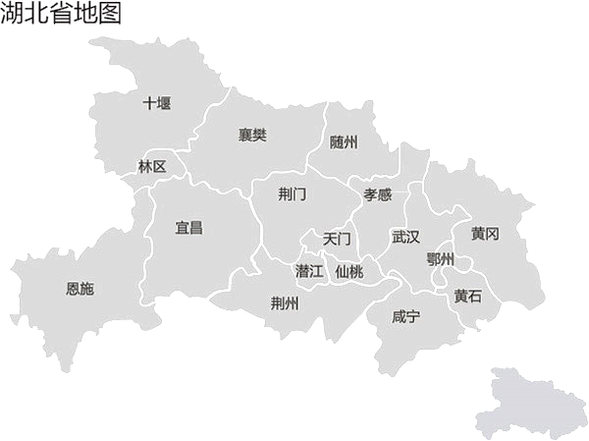
Financial Results
ESG Progress
Expansion of Operational Locations
Capacity Enhancement
Hubei Laserware Laser Technology Co., Ltd.
．Primary Customers: Taiwan-funded board factories
．Planned Factory Location: Huangjinshan Industrial
Park (Huangshi), Hubei, China
．Expected Progress: Complete factory construction
and start production in Y24Q3
．Main Business: Drilling Service

Slide 13
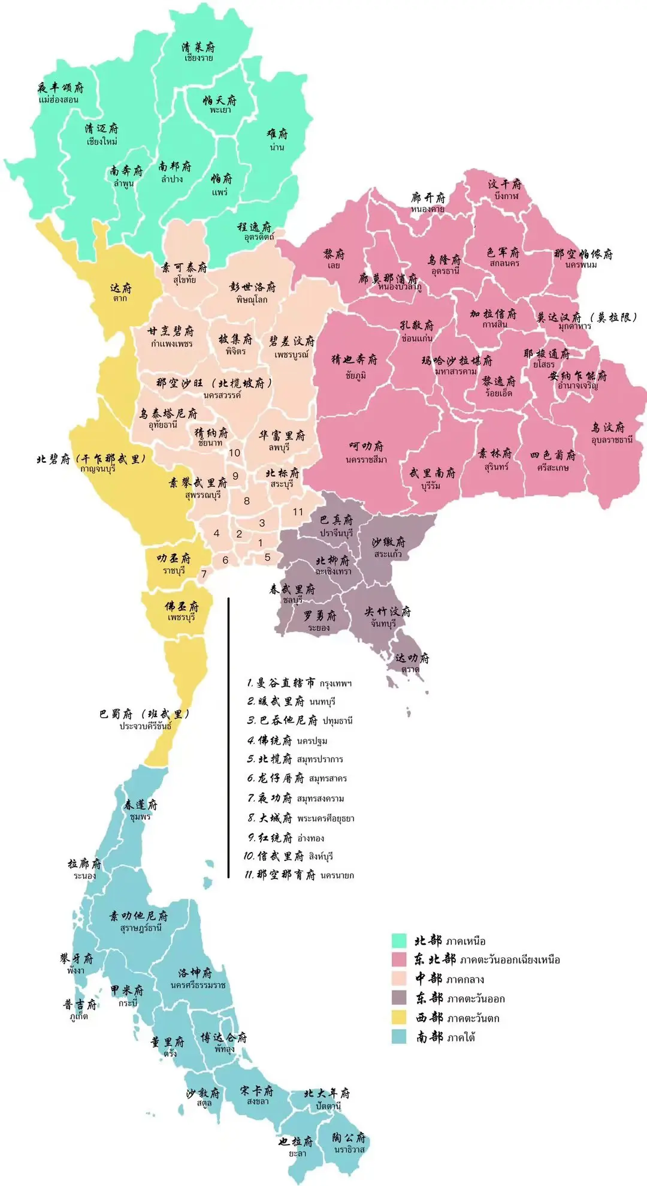

Financial Results
ESG Progress
Capacity Enhancement
Expansion of Operational Locations
Key Ware Electronics (Thailand) Co., Ltd.
．Target Customers: Taiwan-funded and Thai-funded board
factories
．Planned Factory Location: 304 Industrial Park, Prachinburi,
Thailand
．Expected Progress (Phase 1): Factory construction in Y24Q3,
start production in Y24Q4
．Main Business: Drill bit manufacturing, drilling service
．Future Development: Adjust Phase 2 expansion plan based
on customer service expansion plans
(expected timeline to begin in Y25Q2)

Slide 14
Financial Results
ESG Progress
Expansion of Operational Locations
Capacity Enhancement
Drill
Drilling Service
25%-30%
20%-30%
Under the Existing Production Capacity, in the Second Half of 2024：
The Drill Bit Division plans to increase drill bit production capacity by an additional 25–30%.
The Drilling Division plans to expand equipment capacity by an additional 20–30%.

Slide 15

Financial Results
ESG Progress
Expansion of Operational Locations
Capacity Enhancement
2030: 30% carbon
reduction target
2024: First edition of the
sustainability report
2050: Net-Zero
Carbon Emissions
2023: Individual greenhouse
gas audit verification
Timeline for Greenhouse Gas Inventory Report
1、2024: Taiwan region inventory operation
2、2026: The Group’s inventory operation
3、2027: Taiwan region audit verification
4、2028： The Group’s audit verification

Slide 16
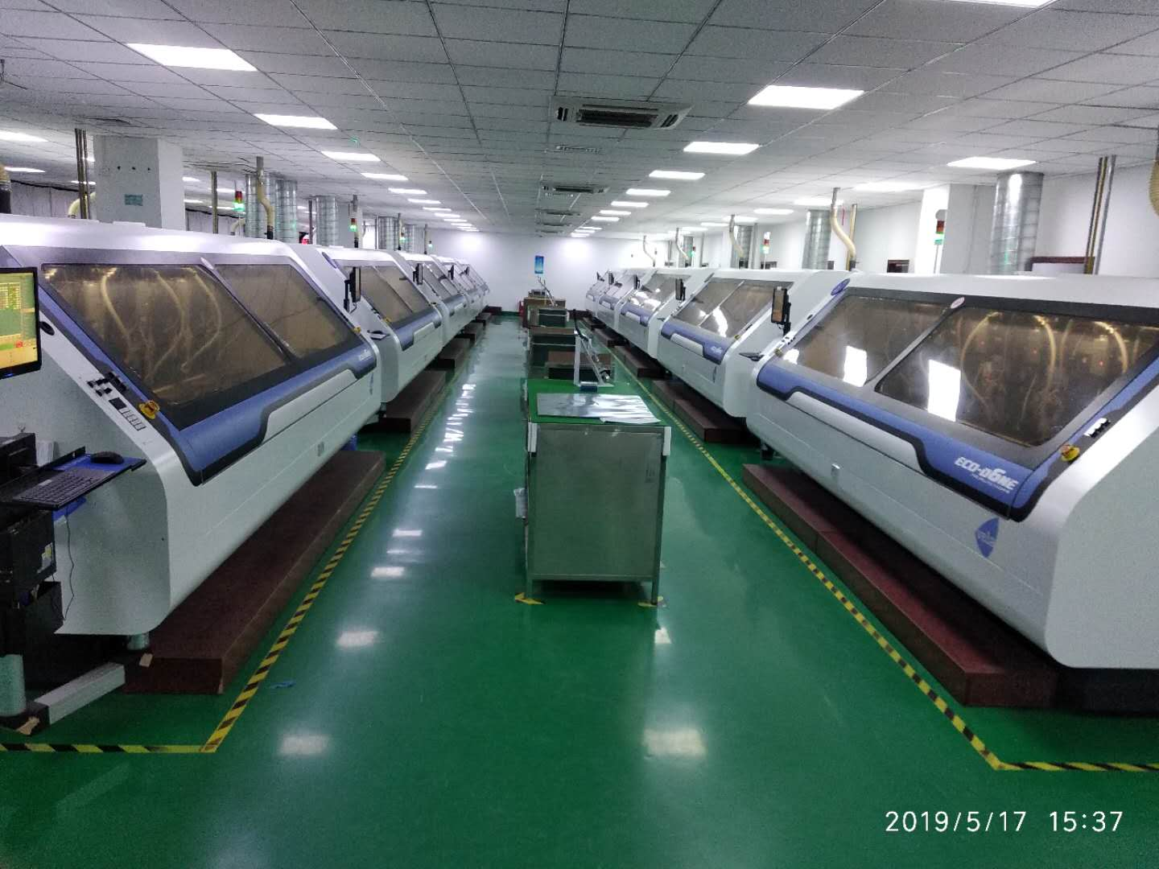
For the further information, please visit our website at： https://www.key-ware.com.tw/
KEY WARE ELECTRONICS
CO., LTD.
Investor Contacts：Sabrina Lee(C.F.O)
Tel：(03)366-0667 ext.188

